Slide 1



Slide 2

Automatic Fresh Fruit Recognition System
Supervised by:
Mr. Yasir Ali Shah
Group Members:
Usman Safdar(FA17-BCS-106)
Aimen Farooq(FA17-BCS-070)
Presented on 07 Dec 2020
Department of Computer Science
COMSATS University Islamabad, Attock Campus

Slide 3
Outline
Introduction
Related Work
Problem Statement
Objectives
Dataset
Methodology
GUI
Tools and Techniques

Slide 4
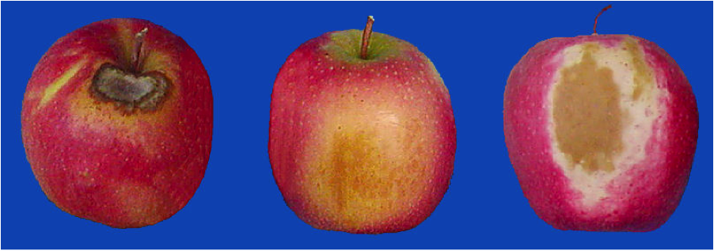
Introduction
This system performs fruit freshness recognition and its classification.
This system use image processing techniques to extract colour, size and other attributes of the image forming training dataset.
This work is driven by the motive to make the effective and efficient system for better checking the freshness of fruit with fast computational speed.
_______________________________

Slide 5
Cont.
In the research, we are designing a complete structure based on neural network techniques to recognize the size, color, shape, and maturity of the fruit.
Currently, we are using Deep Learning (DL) commonly used Machine Learning (ML) method in our recognition system.
Deep Learning Techniques are characterized by their high level of abstraction and the ability to automatically learn and recognize different modes of images once they have been trained.

Slide 6
Related Work
1.4.1 Fruit Recognition System
Y.Song, proposed method for recognizing and counting fruits from images in cluttered greenhouses.
1.4.2 Fruit Detection using Deep Learning
Inkyu Sa, presents a novel approach for detecting fruits from images using deep neural networks. For this purpose, the author adapts a Faster Region-based convolutional network.
1.4.3 Deep Fruit Detection in Orchards
Bargoti S, proposed autonomous robots used for harvesting. It shows a network trained to recognize fruits in an orchard.

Slide 7
Problem Statement
As most of the economic sector and people all over the world rely on fruits as the quality of the fruits is necessary, but to analyze the fruits still old traditional methods are used by the farmers or customers that consume more time and effort. So, in this research, our main aim is to identify the problems related to the automatic fruit freshness system. This will help farmers, later on, the wholesale dealers, and in the end, the customers to check the fruit freshness based on its maturity, color, size, and shape. There is a need to expand the different types of visual characteristics such as color, texture, size, and shape to distinguish between a rotten and unrotten fruit.

Slide 8
Objectives
Fruit Freshness recognition and classification.
Used in Real time applications.
Fast Computational time.
Less prone to human error.
Robust and flexible to large data.
Cost effective.
_______________________________

Slide 9
Dataset
Fruits fresh and rotten for classification(Apples, Oranges, Bananas) Dataset.
Author: Sriram Reddy Kalluri.
Reference: Kalluri, S. R. (2018, August 24). Fruits fresh and rotten for classification. Retrieved October 7, 2020, from https://www.kaggle.com/sriramr/fruits-fresh-and-rotten-for-classification
Images | Fruits | Classes
10,000+ | 3 | Rotten Apples Unrotten Apples Rotten Bananas Unrotten Bananas Rotten Oranges Unrotten Oranges

Slide 10
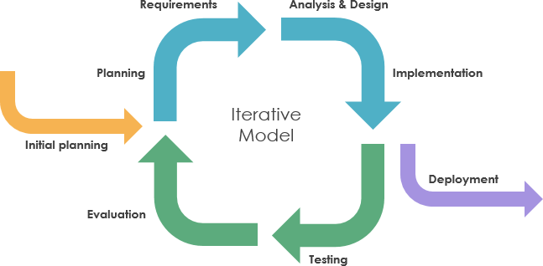
Methodology
We would be using Iterative Model because Requirements of Software are first broken down into several chunks that can be incrementally constructed and delivered. At any time, the plan is made just for the next increment and not for any kind of long-term plans. Therefore, it is easier to modify the version as per the needs.

Slide 11
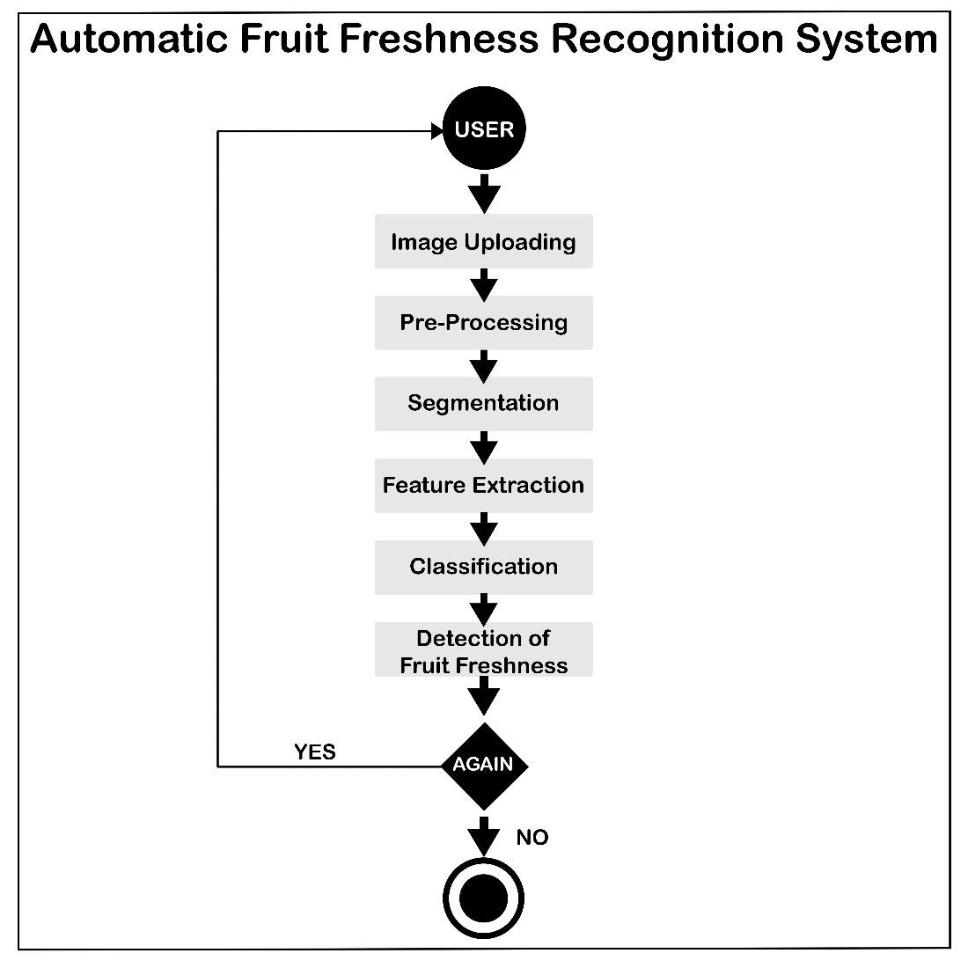
System Architecture

Slide 12
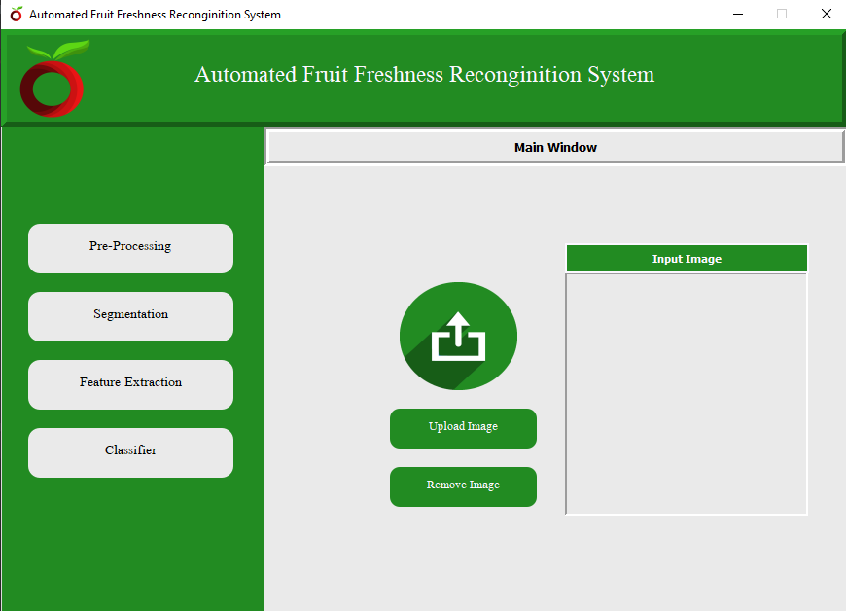
User Interface
_________________________

Slide 13
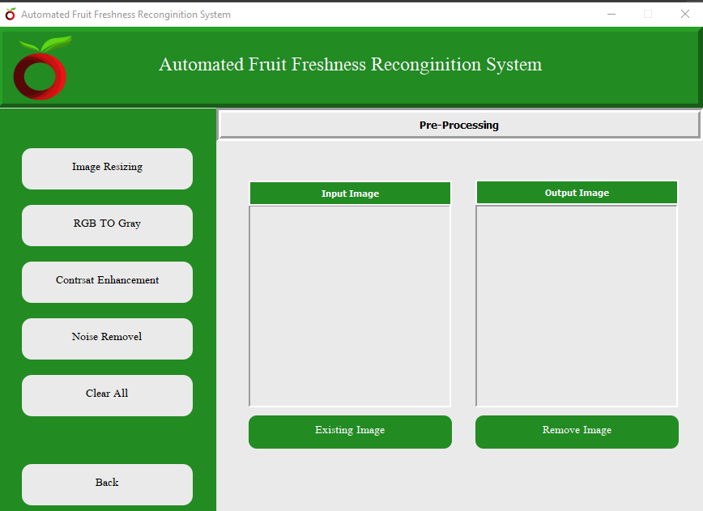
Pre Processing
_________________________

Slide 14
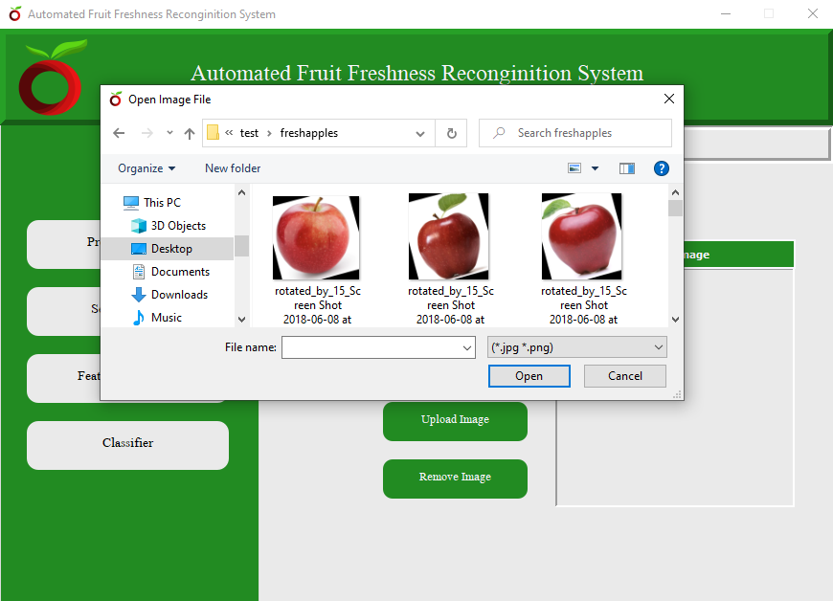
Input Source Image

Slide 15
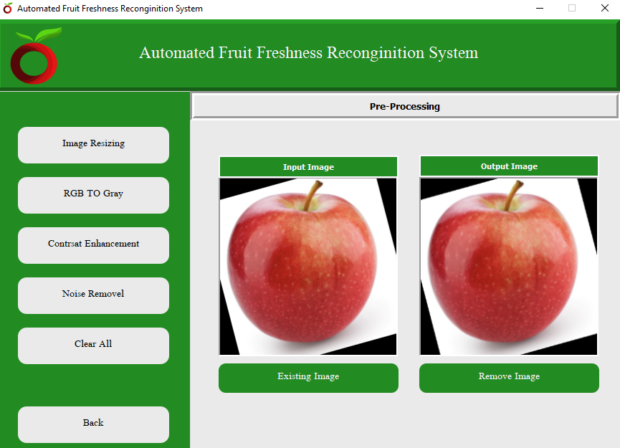
Pre-Processing : Image Resizing

Slide 16
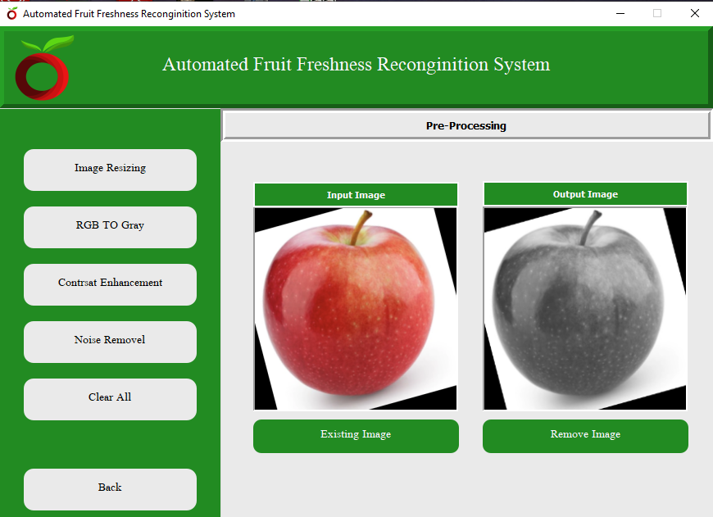
Pre-Processing : BGR to Grey

Slide 17
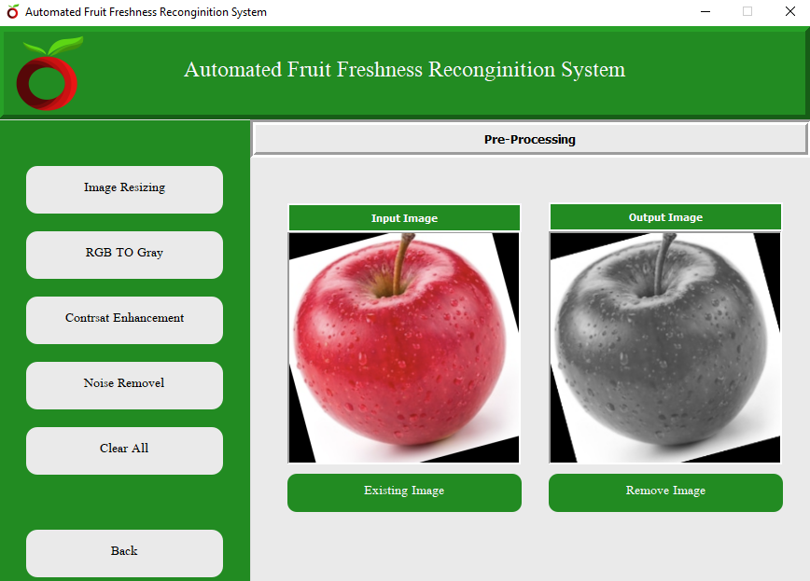
Pre-Processing: Color Enhancement

Slide 18

Pre-Processing: Noise Removal

Slide 19
Tools and Techniques
Tools:
PYCHARM, PYQT5 DESIGNER,
ANACONDA, MS WORD
PYTHON 3.8 IDE
Languages:
Machine learning (python)
_______________________________

Slide 20
References
Sa, I., Ge, Z., Dayoub, F., Upcroft, B., Perez, T., & McCool, C. (2016). DeepFruits: A Fruit Detection System Using Deep Neural Networks. Sensors, 16(8), 1222. https://doi.org/10.3390/s16081222
Song, Y., Glasbey, C. A., Horgan, G. W., Polder, G., Dieleman, J. A., & van der Heijden, G. W. A. M. (2014). Automatic fruit recognition and counting from multiple images. Biosystems Engineering, 118, 203–215. https://doi.org/10.1016/j.biosystemseng.2013.12.008
Bargoti, S., & Underwood, J. (2017). Deep fruit detection in orchards. 2017 IEEE International Conference on Robotics and Automation (ICRA). https://doi.org/10.1109/icra.2017.7989417
h Fu, Y., 2020. Fruit Freshness Grading Using Deep Learning. [ebook] School of Engineering, Computer and Mathematical Sciences. Available at: <https://openrepository.aut.ac.nz/bitstream/handle/10292/13353/Fruit_Fu_24May2020_wyan.pdf> [Accessed 7 October 2020].
_______________________________

Slide 21
THANK YOU

